Slide 1
Stock Price Prediction Based on Hidden Markov Model
Runze Yan(rj4jr)

Slide 2
Problem Description
The stock market is an important indicator which reflects economic strengths and weaknesses
The stock market is very complex and the future stock price depends on many internal and external factors that are not easy to evaluate
Directly incorporate the continuous Hidden Markov Model (HMM)
Predict the next day stock price given the historical data

Slide 3
Reasons of using Hidden Markov Model (HMM)

Slide 4
Reasons of using HMM
HMMs are capable of predicting and analyzing time-based phenomena
The price of the stock depends upon a multitude of factors, which generally remain invisible to the investor (hidden variables)
The transition between the underlying factors change based on company policy and decisions, its financial conditions, and management decisions, and these affect the price of the stock (observed data)

Slide 5
Previous Researches
Support Vector Machine (SVM)
Time series ARIMA
Fuzzy Logic
Artificial Neural Networks (ANN)
Multilayer Perceptron (MLP)
Long Short-term Memory (LSTM)

Slide 6
Introduction to Hidden Markov Model(HMM)

Slide 7
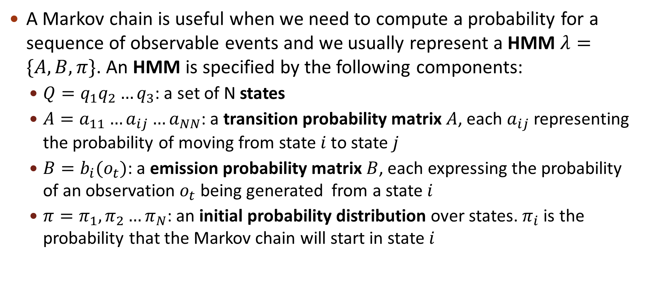
Hidden Markov Model (HMM)
A Markov chain is useful when we need to compute a probability for a sequence of observable events and we usually represent a HMM $λ=\{A,B,π\}$. An HMM is specified by the following components:
$Q=q_{1}q_{2}…q_{3}$: a set of N states
$A=a_{11}…a_{ij}…a_{NN}$: a transition probability matrix $A$, each $a_{ij}$ representing the probability of moving from state $i$ to state $j$
$B=b_{i}(o_{t})$: a emission probability matrix $B$, each expressing the probability of an observation $o_{t}$ being generated from a state$i$
$π=π_{1}, π_{2}…π_{N}$: an initial probability distribution over states. $π_{i}$ is the probability that the Markov chain will start in state $i$

Slide 8
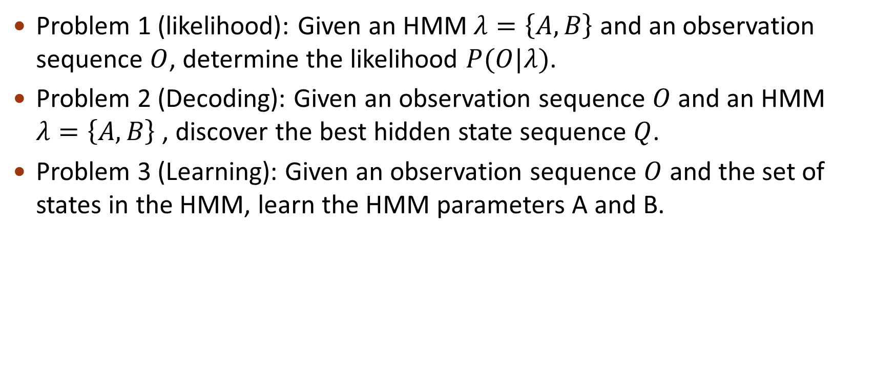
Three fundamental problems
Problem 1 (likelihood): Given an HMM $λ=\left\{A,B\right\}$ and an observation sequence $O$, determine the likelihood $P(O|λ)$.
Problem 2 (Decoding): Given an observation sequence $O$ and an HMM $λ=\left\{A,B\right\}$ , discover the best hidden state sequence $Q$.
Problem 3 (Learning): Given an observation sequence $O$ and the set of states in the HMM, learn the HMM parameters A and B.

Slide 9
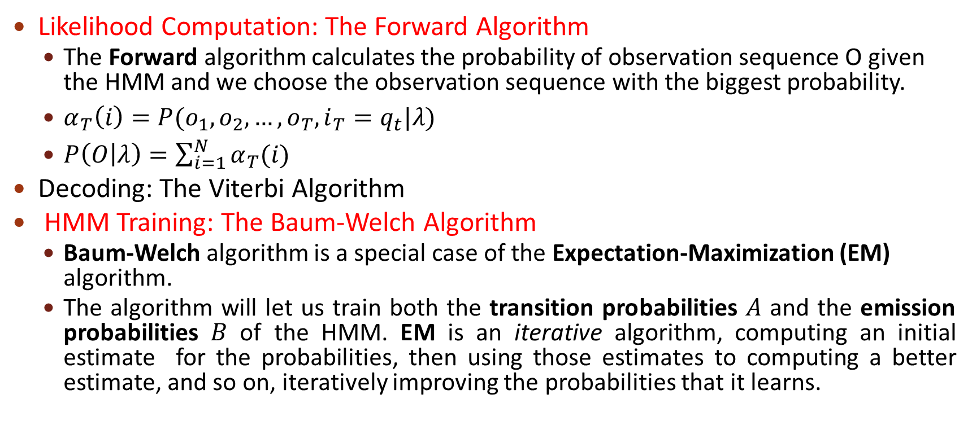
Three basic algorithms
Likelihood Computation: The Forward Algorithm
The Forward algorithm calculates the probability of observation sequence O given the HMM and we choose the observation sequence with the biggest probability.
$α_{T}\left(i\right)=P(o_{1},o_{2},…,o_{T},i_{T}=q_{t}|λ)$
$P\left(O | λ\right)=\sum_{i=1}^{N}{α_{T}(i)}$
Decoding: The Viterbi Algorithm
HMM Training: The Baum-Welch Algorithm
Baum-Welch algorithm is a special case of the Expectation-Maximization (EM) algorithm.
The algorithm will let us train both the transition probabilities $A$ and the emission probabilities $B$ of the HMM. EM is an iterative algorithm, computing an initial estimate for the probabilities, then using those estimates to computing a better estimate, and so on, iteratively improving the probabilities that it learns.

Slide 10
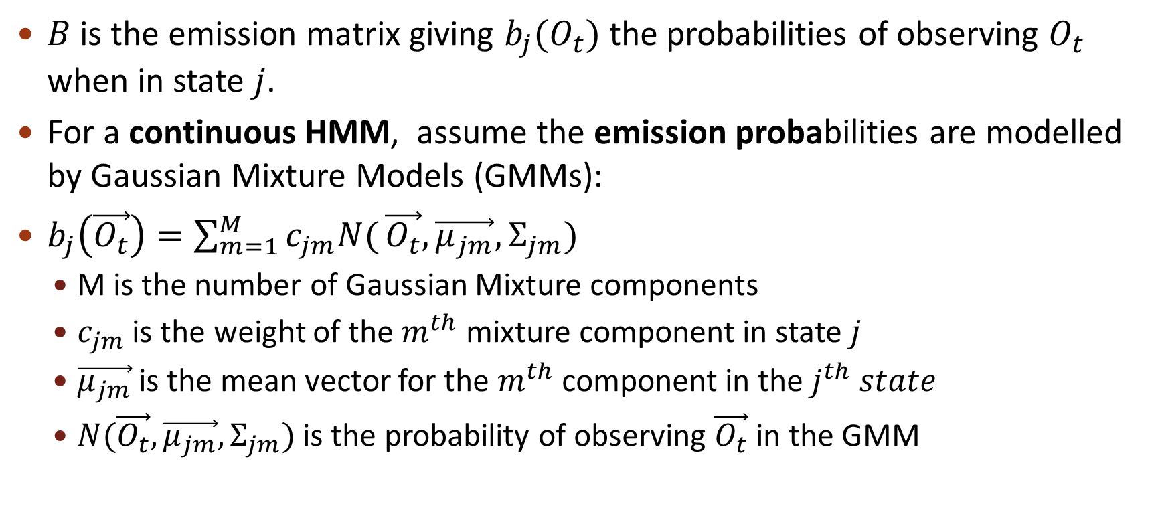
Emission probabilities
$B$ is the emission matrix giving $b_{j}(O_{t})$ the probabilities of observing $O_{t}$ when in state $j$.
For a continuous HMM, assume the emission probabilities are modelled by Gaussian Mixture Models (GMMs):
$b_{j}\left(\vec{O_{t}}\right)=\sum_{m=1}^{M}{c_{jm}N(}\vec{O_{t}},\vec{μ_{jm}},Σ_{jm})$
M is the number of Gaussian Mixture components
$c_{jm}$ is the weight of the $m^{th}$ mixture component in state $j$
$\vec{μ_{jm}}$ is the mean vector for the $m^{th}$ component in the $j^{th} state$
$N(\vec{O_{t}},\vec{μ_{jm}},Σ_{jm})$ is the probability of observing $\vec{O_{t}}$ in the GMM

Slide 11
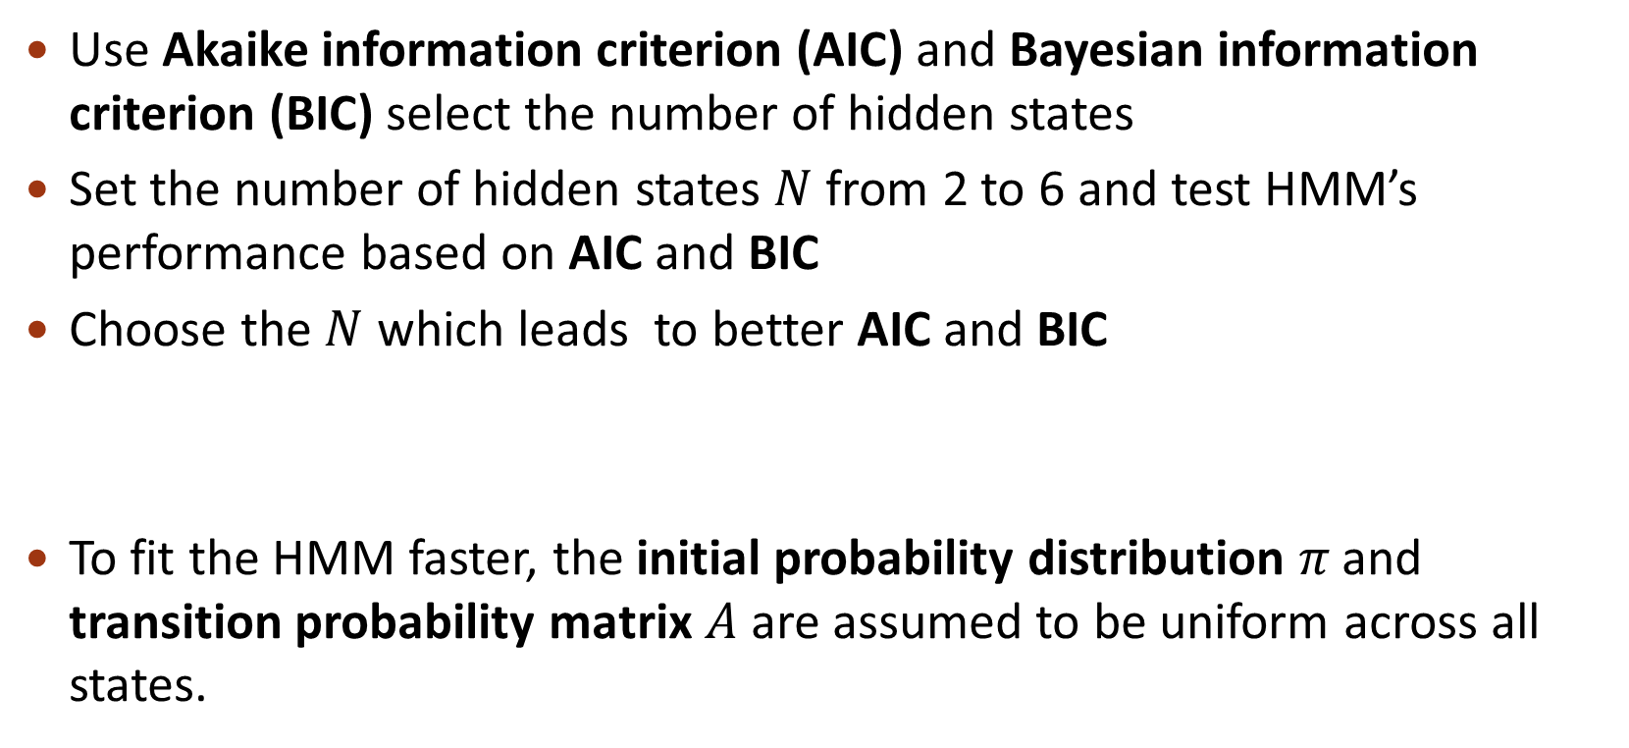
Number of states
Use Akaike information criterion (AIC) and Bayesian information criterion (BIC) select the number of hidden states
Set the number of hidden states $N$ from 2 to 6 and test HMM’s performance based on AIC and BIC
Choose the $N$ which leads to better AIC and BIC
To fit the HMM faster, the initial probability distribution 𝜋 and transition probability matrix 𝐴 are assumed to be uniform across all states.
Initial probabilities and transition probabilities

Slide 12
Simulation and Results

Slide 13
Datasets
I choose the stock price datasets of Apple and Amazon. These two datasets contain the close price, open price, high price and closing price.
Split the datasets into train dataset and test dataset.
Observation | Training Dataset |  | Testing Dataset
 | From | Till | From | Till
Apple | 1/2/2014 | 8/31/2017 | 9/1/2017 | 12/31/2018
Amazon | 1/2/2014 | 8/31/2017 | 9/1/2017 | 12/31/2018

Slide 14
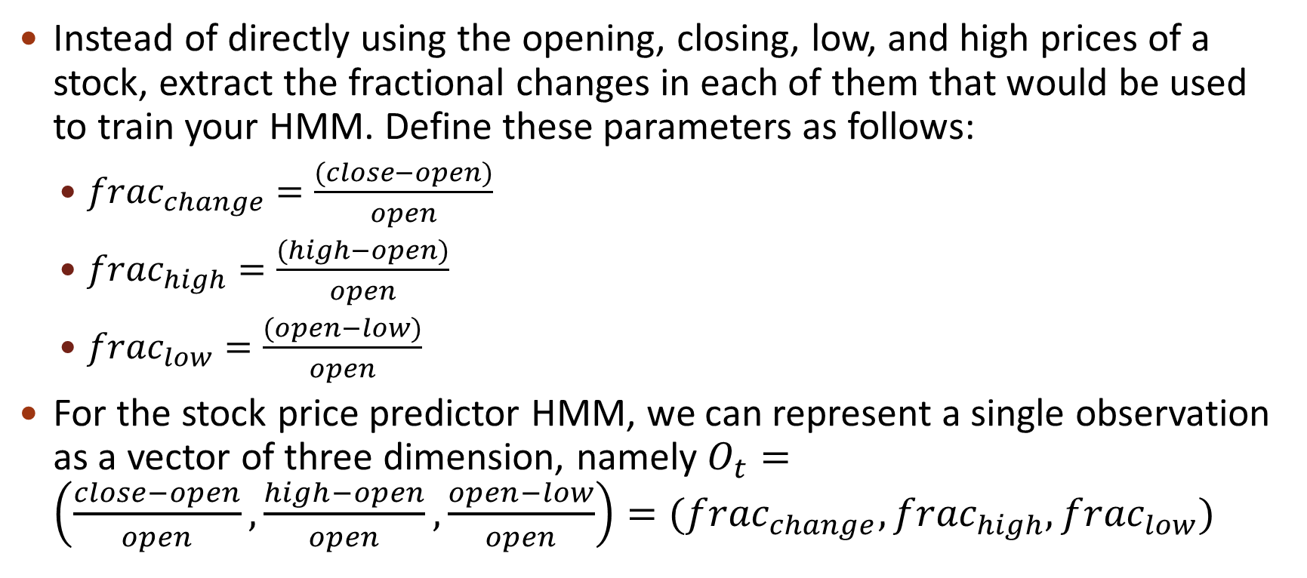
Build new features
Instead of directly using the opening, closing, low, and high prices of a stock, extract the fractional changes in each of them that would be used to train your HMM. Define these parameters as follows:
${frac}_{change}=\frac{(close−open)}{open}$
${frac}_{high}=\frac{(high−open)}{open}$
${frac}_{low}=\frac{(open−low)}{open}$
For the stock price predictor HMM, we can represent a single observation as a vector of three dimension, namely $O_{t}=\left(\frac{close−open}{open},\frac{high−open}{open},\frac{open−low}{open}\right)=({frac}_{change},{frac}_{high},{frac}_{low})$

Slide 15
Train
Train the above HMM from given sequences of observations using Baum-Welch algorithm which uses Expectation-Maximization (EM) to arrive at the optimal parameters for the HMM.
With the help of GaussianHMM class provided by the hmmlearn package, implement the function of Baum-Welch algorithm.

Slide 16
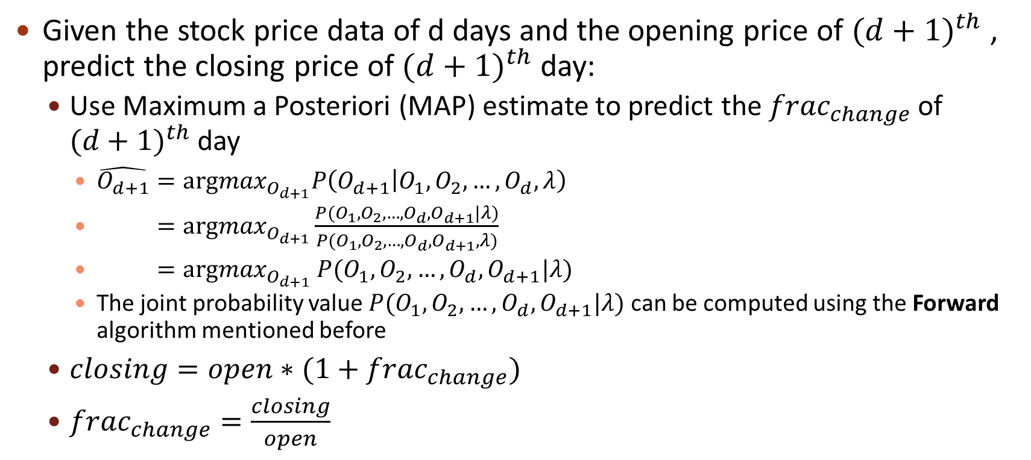
Prediction
Given the stock price data of d days and the opening price of ${(d+1)}^{th}$ , predict the closing price of ${(d+1)}^{th}$day:
Use Maximum a Posteriori (MAP) estimate to predict the ${frac}_{change}$ of ${(d+1)}^{th}$day
$\hat{O_{d+1}}={argmax}_{O_{d+1}}P\left(O_{d+1} | O_{1},O_{2},…,O_{d},λ\right)$
$={argmax}_{O_{d+1}}\frac{P(O_{1},O_{2},…,O_{d},O_{d+1}|λ)}{P(O_{1},O_{2},…,O_{d},O_{d+1},λ)}$
$={argmax}_{O_{d+1}}$ $P(O_{1},O_{2},…,O_{d},O_{d+1}|λ)$
The joint probability value $P(O_{1},O_{2},…,O_{d},O_{d+1}|λ)$ can be computed using the Forward algorithm mentioned before
$closing=open∗(1+{frac}_{change})$
${frac}_{change}=\frac{closing}{open}$

Slide 17
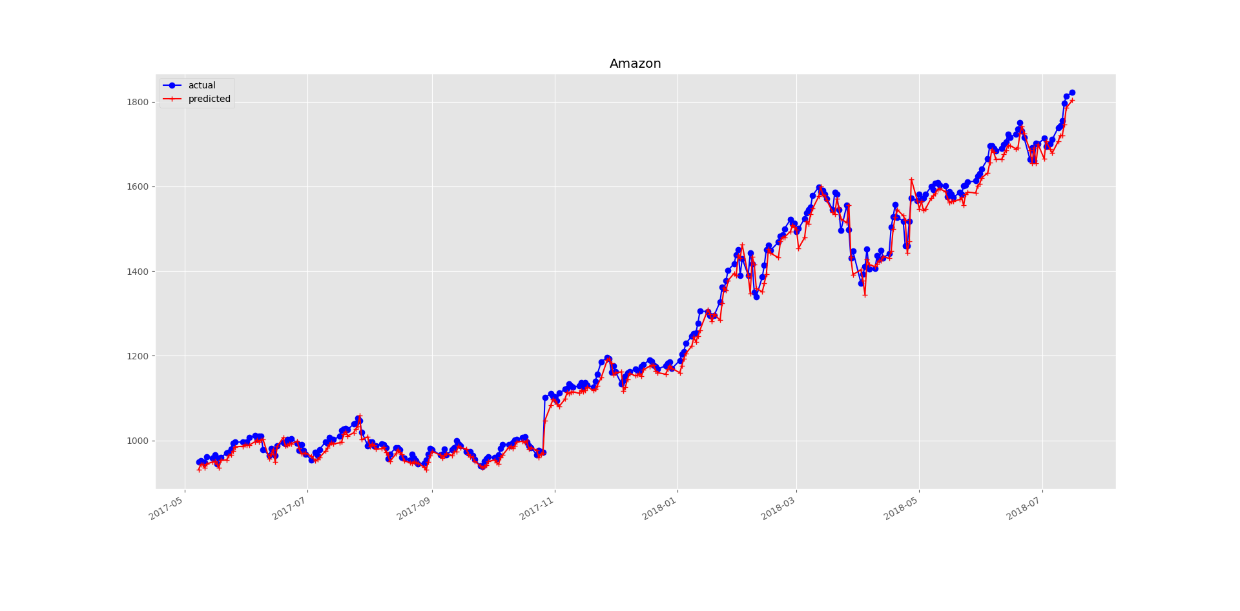
Prediction results-Amazon

Slide 18
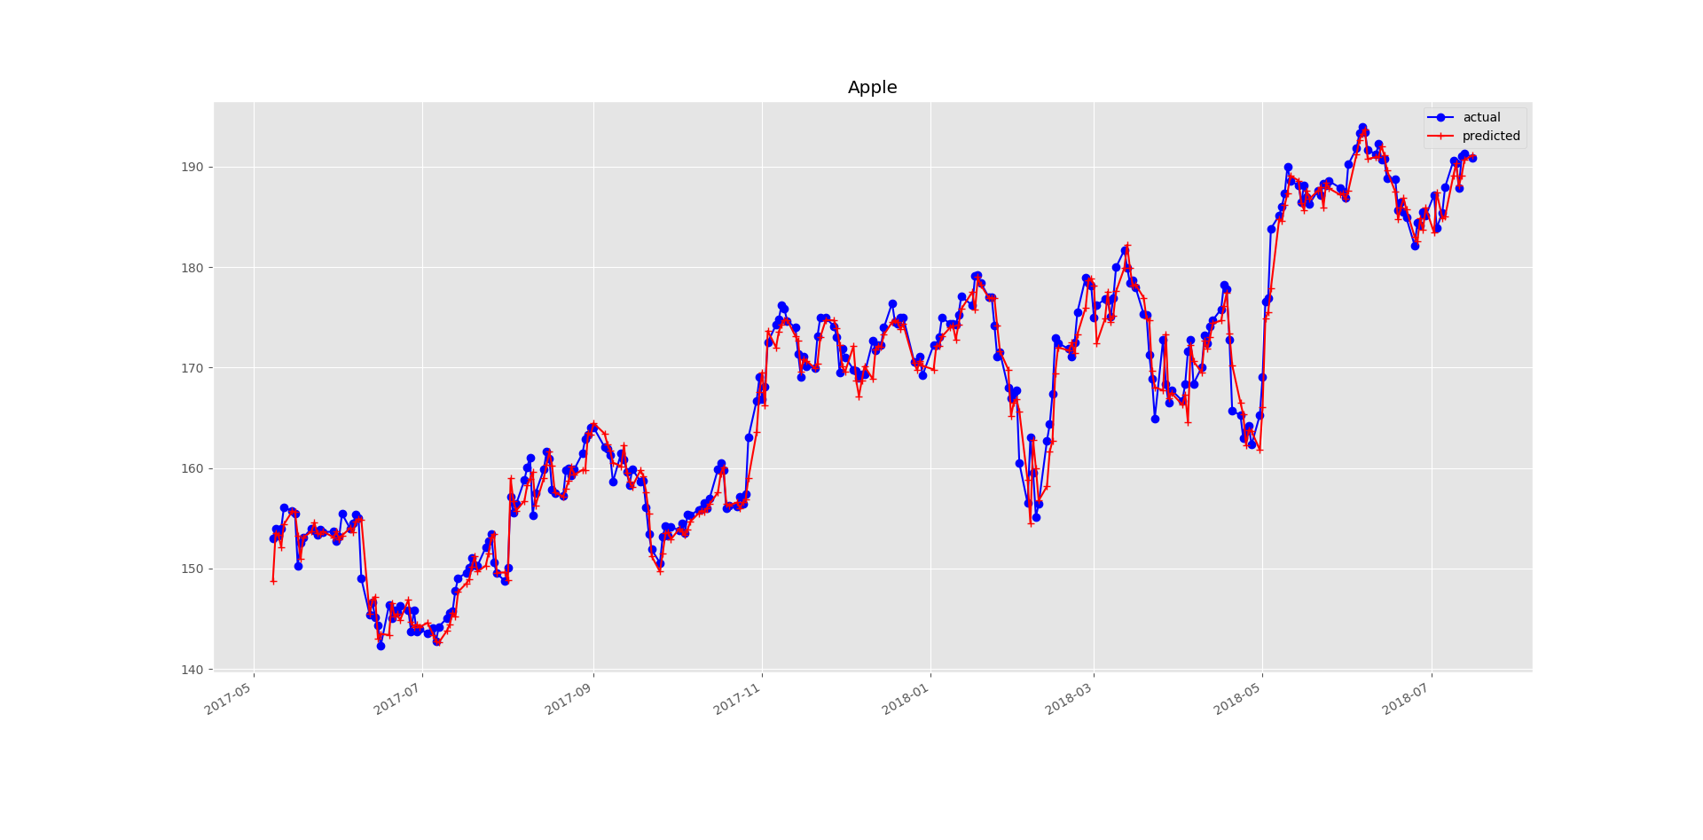
Prediction results-Apple

Slide 19
Test
Use Root mean Square deviation(RSME) and Mean Absolute Percentage Error(MAPE) to evaluate the prediction error.
Compare the performance of HMM with SVM, ARIMA and ANN:
 | HMM | SVM | ARIMA | ANN
RSME | 1.51 | - | 1.8 | 0.96
MAPE | 0.72 | 0.77 | - | 0.66

Slide 20

Deficiency and work in the future
The emission probabilities are modelled by Gaussian Mixture Models (GMMs) and neural networks may have better performance
Use AIC and BIC to select the number of states $N$ can lead to high algorithm complexity. AIC and BIC may get different results.

Slide 21
Thank you
Question

